Slide 1
Geographic Analysis of Craft Breweries in the United States
Video Presentation:
https://www.youtube.com/watch?v=XgoDy0ZKkrc
Jon Paugh
Jason Rupp
DDS 6306

Slide 2


Craft Beer Data
Craft Breweries
Craft Beers

Slide 3
Notes:
Fix this graph

Slide 4
Imput Missing Values
Beer Judges Certification Program Style Guidelines: https://www.bjcp.org/stylecenter.php
Found ranges of for missing values (ibu/abv)
Computed and imputed mean by class
IBU 41.7 % missing reduced to 24.32%

Slide 5
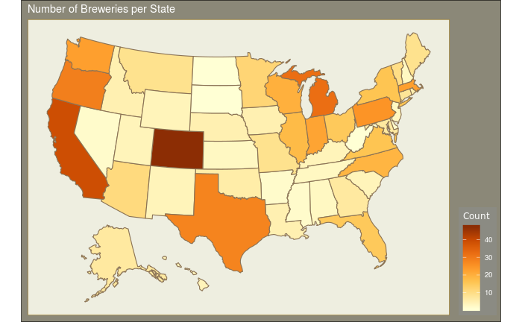
How Many Breweries per State?
Top 3 States = CO, CA, MI
Bottom 3 States = DC, ND, SD

Slide 6
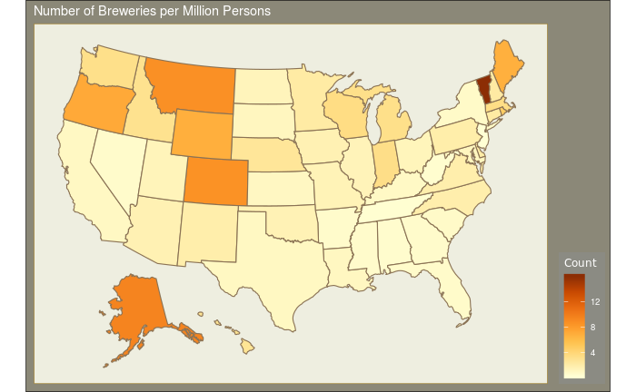
Breweries per Million Population by State
Top 3 State = VT, AK, MT
Bottom 3 States = WV, TN, NJ

Slide 7
Mean ABV by Brewery State
Notes:
UT max 0.4 ABV for beer sold in convenience and grocery stores

Slide 8
Mean IBU by Brewery State

Slide 9
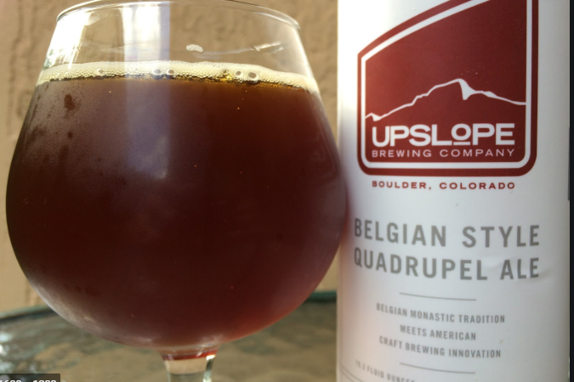
State with Maximum Alcoholic Beer
0.128 ABV!
Upslope Brewing Company
Boulder,CO
Lee Hill Series Vol. 5 - Belgian Style Quadrupel Ale
Notes:
Wine average abv is 10%! Pinot grigio = 12-13%

Slide 10


State with Most Bitter Beer
IBU = 138

Slide 11



Summary Statistics of ABV
Mean ABV = 0.60. Standard Dev = 0.014.
ABV appears to be a right skewed distribution. Most Beer ABV is below 0.10, with only a few outliers.

Slide 12
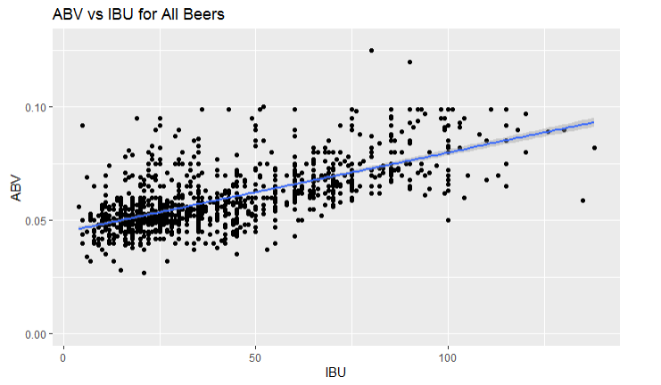
ABV v. IBU
The data suggests that there is a high correlation between IBU and ABV.
Generally speaking as IBU increases, so does ABV.
Notes:
IBU is a measure of bitterness of the beer (based on the amount of hops added, but not necessarily taste). ABV, or alcohol by volume, measures the strength of the alcohol in the beer. Hops do not directly contribute to higher ABV. So this appears to be more a style choice by the brewer.

Slide 13
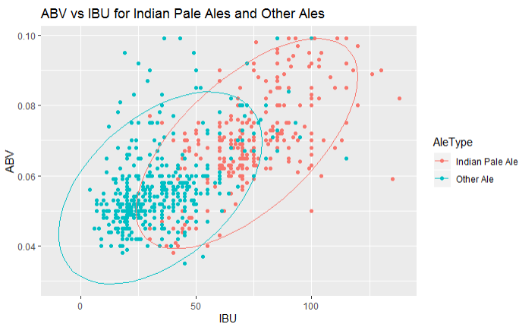
ABV and IBU for IPA vs. All Other Ales

Slide 14
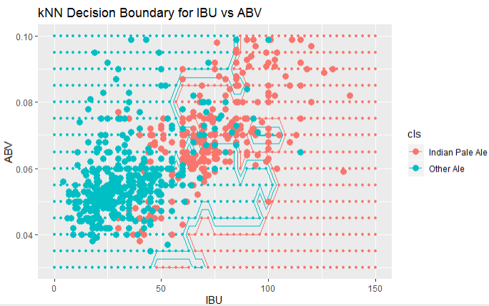
Use K Nearest Neighbor Algorithm to Distinguish IPA vs All Other Ales
For k = 11 : Accuracy is 84%, Sensitivity = 80%, Specificity = 88%
Notes:
Sensitivity = true positive rate, Specificity = true negative rate

Slide 15
Breweries per Million Population by State
Top 3 State = VT, AK, MT
Bottom 3 States = WV, TN, NJ

Slide 16
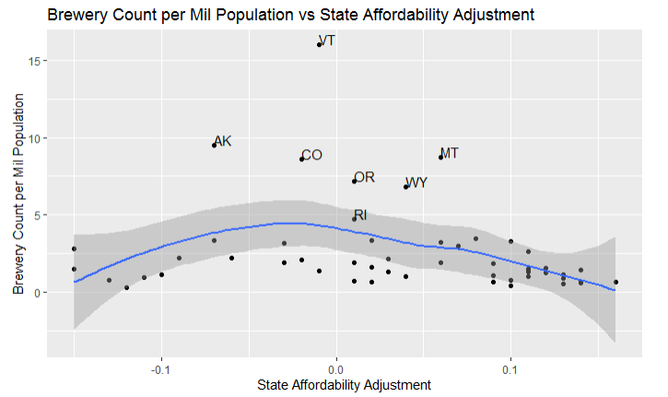
Highest Number of Breweries per Population in States with Average State Affordability
https://taxfoundation.org/new-state-level-price-data-shows-smaller-state-real-income-differences/

Slide 17
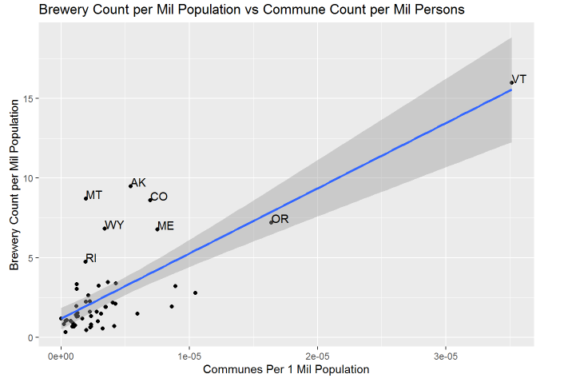

“Hippie” States? Craft Breweries vs Communes per Million Population

Slide 18
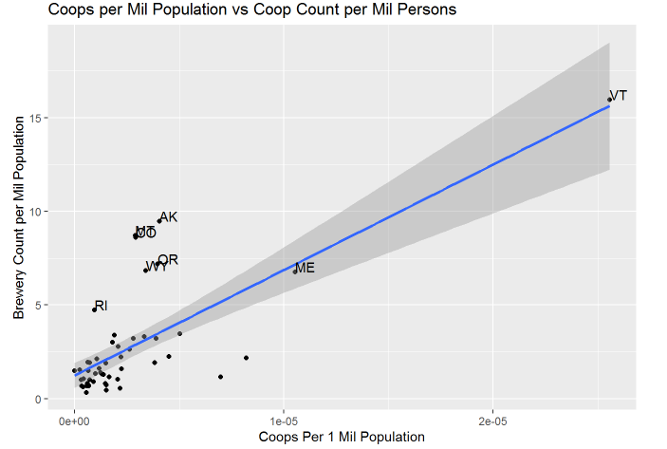
Craft Breweries vs. Coops per Million Population
Values
Cooperatives are based on the values of self-help, self-responsibility, democracy, equality, and solidarity. In the tradition of their founders, cooperative members believe in the ethical values of honesty, openness, social responsibility, and caring for others.
https://www.eastendfood.coop/what-is-a-co-op/

Slide 19
States with Middle Affordability and “Hippie” Characteristics (Communes + Coops)

Slide 20
Use Cost of Living, Coops, and Communes to Find Next Market for Craft Breweries
Abbr | Name | Cost Adjustment | Communes per 1 Million Pop | Coops per 1 Million Pop | Breweries per 1 Million Pop
HI | Hawaii | -0.15 | 1.05E-05 | 2.10E-06 | 2.79407
MN | Minnesota | 0.03 | 4.01E-06 | 8.20E-06 | 2.18595
NM | New Mexico | 0.06 | 8.63E-06 | 3.84E-06 | 1.91837
WA | Washington | -0.03 | 8.93E-06 | 3.90E-06 | 3.20765

